Slide 1

CENG 334 – Operating Systems
04- Deadlocks
Asst. Prof. Yusuf Sahillioğlu
Computer Eng. Dept, , Turkey

Slide 2
Outline
<number> / 51
The Deadlock Problem
System Model
Deadlock Characterization
Methods for Handling Deadlocks
Deadlock Prevention
Deadlock Avoidance
Deadlock Detection
Recovery from Deadlock

Slide 3
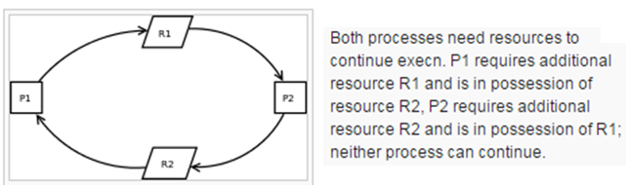
Definition & Examples
<number> / 51
Deadlock: A set of blocked processes each holding a resource and waiting to acquire a resource held by another process in the set.
Example:
  System has 2 disk drives: R1 & R2.
  P1 and P2 each holds one disk drive and each needs another one.
Example:
  semaphores A and B, initialized to 1. (not always: depends on CS).
  P0 P1
  wait(A); //context-switch (CS) wait(B);
  wait(B); wait(A);

Slide 4
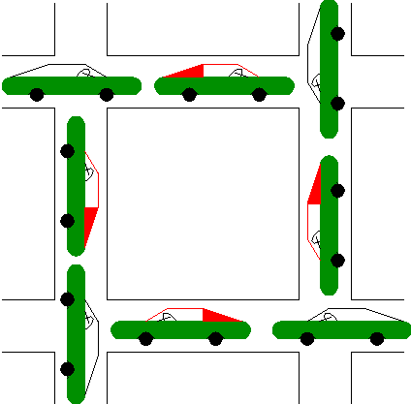
Definition & Examples
<number> / 51
Deadlock: A set of blocked processes each holding a resource and waiting to acquire a resource held by another process in the set.

Slide 5
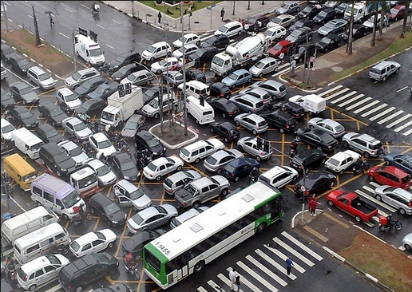
Definition & Examples
<number> / 51
Deadlock: A set of blocked processes each holding a resource and waiting to acquire a resource held by another process in the set.

Slide 6
Definition & Examples
<number> / 51
Deadlock: A set of blocked processes each holding a resource and waiting to acquire a resource held by another process in the set.
Traffic only in one direction.
If a deadlock occurs, it can be resolved if one car backs up (preempt resources and rollback).
Several cars may have to be backed up if a deadlock occurs.
Starvation is possible.
Note: Most OSes do not prevent or deal with deadlocks. It’s app. programmer’s duty (kill, reboot, ..).
section1 section2
Notes:
Each section of a bridge can be viewed as a resource. Each car is a process.

Slide 7
Conditions
<number> / 51
Deadlocks can arise if 4 conditions hold simulataneously:
  Mutual exclusion: only one process at a time can use a resource (another process P2 cannot access while P1 is using).
  Hold and wait: a process holding at least one resource is waiting to acquire additional resources held by other processes
  No preemption: a resource can be released only voluntarily by the process holding it, after that process has completed its task
  Circular wait: there exists a set {P0, P1, …, Pn} of waiting processes such that P0 is waiting for a resource that is held by P1, P1 is waiting for a resource that is held by P2, …, Pn–1 is waiting for a resource that is held by Pn, and Pn is waiting for a resource that is held by P0.
Notes:
Mutex: Resources should be accessed in a mutually exclusive manner.

Slide 8
Solutions
<number> / 51
Current OSes do not deal with deadlocks.
Some solutions that might be implemented in future OSes.
System model.
  Resource types R1, R2, . . ., Rm
  CPU cycles, memory space, I/O devices (scanners).
  Each resource type Ri has Wi instances.
  Each process utilizes a resource as follows:
    request (may cause the process to wait); e.g. fopen() -> open()
    use
    Release; e.g. fclose() -> close()

Slide 9
Deadlock Representation
<number> / 51
Use resource-allocation graph: A set of vertices V & edges E.
V is partitioned into two types:
  P = {P1, P2, …, Pn}, the set consisting of all the processes in the system
  R = {R1, R2, …, Rm}, the set consisting of all resource types in the system
request edge: directed edge Pi → Rj //Pi is waiting for Rj
assignment edge: directed edge Rj → Pi

Slide 10
Deadlock Representation
<number> / 51
Process
Resource Type with 4 instances
Pi requests instance of Rj
Pi is holding an instance of Rj
P_{i}
R_{j}
P_{i}
R_{j}

Slide 11

Deadlock Representation
<number> / 51
Example of a resource-allocation graph at time t:

Slide 12

Deadlock Representation
<number> / 51
Example of a resource-allocation graph with a deadlock:

Slide 13
Deadlock Representation
<number> / 51
Example of a resource-allocation graph with a deadlock:
All resources are held by waiting processes. Since the waiting processes will not run they will not release the resources ➔ deadlock!

Slide 14

Deadlock Representation
<number> / 51
Graph with a cycle but no deadlock:

Slide 15
Deadlock Representation
<number> / 51
Graph with a cycle but no deadlock:
P2 & P4, which are not in waiting mode, will release their resources.

Slide 16
Deadlock Representation
<number> / 51
Basic conclusions on resource-alloc graphs:
If graph contains no cycles → no deadlock
If graph contains a cycle:
  if only one instance per resource type, then deadlock
  if several instances per resource type, possibility of deadlock
So resource-alloc graph is useful for deadlock detection

Slide 17
Deadlock Handling
<number> / 51
Deadlock prevention/avoidance
Deadlock detection needed
Ignore the problem and pretend that deadlocks never occur in the system
  Used by most operating systems, including UNIX
  No deadlock handling in kernel ‘cos detecting/preventing/avoiding is costly: admin/user stops/restarts processes.

Slide 18
Deadlock Prevention vs. Avoidance
<number> / 51
Prevention: ensure at least 1 of the 4 conditions is false.
Avoidance: ensure system is never in unsafe state where deadlock is possible, e.g., Banker’s algorithm.

Slide 19
Deadlock Prevention
<number> / 51
Basic principle: restrict the ways requests can be made
If 1 of the 4 simulataneous conditions FALSE, then no deadlock.
  Try to negate one of those 4.
Mutual Exclusion: if all resources are sharable, many processes can access them whenever they want.
  Convert non-sharable -> sharable: spooling sw for printers.
Hold and Wait: must guarantee that whenever a process requests a resource, it does not hold any other resources
  Require process to request and be allocated all its resources before it begins execution, or allow process to request resources only when the process has none
  Low resource utilization; starvation possible
Notes:
not required for sharable resources: if all resources are sharable, many processes can access them whenever they want.
not required for enough resources: If # resources is sufficient for processes, many processes can access them whenever they want.
Spooling: works in background; takes the file to be printed; prints whenever printer becomes ready; app that calls print() not blocked – it just informs the spooler.

Slide 20
Deadlock Prevention
<number> / 51
Basic principle: restrict the ways requests can be made
If 1 of the 4 simulataneous conditions FALSE, then no deadlock.
  Try to negate one of those 4.
No Preemption
  If a process that is holding some resources requests another resource that cannot be immediately allocated to it, then all resources currently being held are released
  Preempted resources are added to the list of resources for which the process is waiting
  Process will be restarted only when it can regain its old resources, as well as the new ones that it is requesting
Circular Wait: impose a total ordering of all resource types, and require that each process requests resources in an increasing order of enumeration: if I request resrc 5, next time I cannot req 4, but 6 or 9.

Slide 21

Deadlock Avoidance
<number> / 51
Basic principle: use a priori info to avoid deadlocks.
A priori info: each process declares the max number of resources of each type that it may need.
Start at safe state; traverse at that space; avoid unsafe states.

Slide 22
Deadlock Avoidance Algorithms
<number> / 51
Two types:
  Single instance for each resource type.
    Use the resource-allocation graph.
  Multiple instances for each resource type.
    Use Banker’s Algorithm.

Slide 23
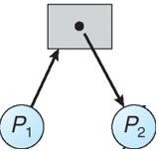
Deadlock Avoidance Algorithms
<number> / 51
Single instance for each resource type.
Besides request edge and allocation edge, we add claim edge.
Claim edge Pi →Rj indicated that process Pi may request resource Rj; represented by a dashed line.
Claim edge converts to request edge when a process requests a resource.
Request edge converted to an assignment edge when the resource is allocated to the process.
When a resource is released by a process, assignment edge reconverts to a claim edge
Resources must be claimed a priori in the system

Slide 24

Deadlock Avoidance Algorithms
<number> / 51
Single instance for each resource type.

Slide 25
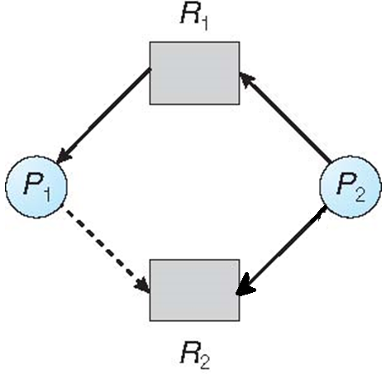
Deadlock Avoidance Algorithms
<number> / 51
Single instance for each resource type.
P2 requests R2; should we allocate?

Slide 26

Deadlock Avoidance Algorithms
<number> / 51
Single instance for each resource type.
If allocation is done, request edge’ll be converted to assignment edge.
This new state has a cycle (unsafe state); so avoid that allocation.
Although there’s no deadlock now, there may be a deadlock: unsafe.

Slide 27
Deadlock Avoidance Algorithms
<number> / 51
Multiple instances for each resource type.
  Banker’s Algorithm.
  Each process must a priori claim maximum use.
  When a process requests a resource it may have to wait.
  When a process gets all its resources it must return them in a finite amount of time.

Slide 28
Deadlock Avoidance Algorithms
<number> / 51
Data structures for the Banker’s Algo.
Let n = number of processes, and m = number of resources types.
  Available: Vector of length m. If available [j] = k, there are k instances of resource type Rj available at that time
  Max: n x m matrix. If Max[i,j] = k, then process Pi may request at most k instances of resource type Rj
  Allocation: n x m matrix. If Allocation[i,j] = k then Pi is currently allocated k instances of Rj
  Need: n x m matrix. If Need[i,j] = k, then Pi may need k more instances of Rj to complete its task
    Need [i,j] = Max[i,j] – Allocation [i,j]

Slide 29
Deadlock Avoidance Algorithms
<number> / 51
Data structures for the Banker’s Algo.
  Available: initially decided by your hw configuration.
  Max: initially declared by process.
  Allocation: initially all 0s.
  Need: initially same as Max.

Slide 30

Deadlock Avoidance Algorithms
<number> / 51
5 processes: P0 through P4;
3 resource types: A (10 instances), B (5instances), and C (7 instances)
Existing vector: [10 5 7]
Available[j] = Existing[j] – Allocation[i, j]
Snapshot at time t:
Allocation Max Need Available
A B C A B C A B C A B C
P0 0 1 0 7 5 3 7 4 3 3 3 2
P1 2 0 0 3 2 2 1 2 2
P2 3 0 2 9 0 2 6 0 0
P3 2 1 1 2 2 2 0 1 1
P4 0 0 2 4 3 3 4 3 1

Slide 31
Deadlock Avoidance Algorithms
<number> / 51
Some notation for the algo.
X X is a matrix.
A B C X_i is the ith row of the matrix; it is a vector: X_3 = [2 1 1].
0 1 0
2 0 0
3 0 2
2 1 1
0 0 2
V V is a vector; V = [3 3 2]. Compare Xi vs. V
A B C V == X_i
3 3 2 V <= X_i //all elmnts <=
V >= X_i //all elements

Slide 32
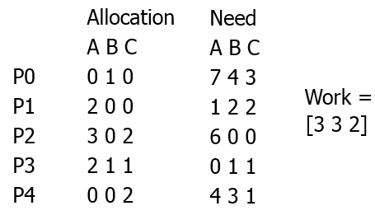
Deadlock Avoidance Algorithms
<number> / 51
Safety-check algorithm: check whether a given state is safe or not?
1. Let Work and Finish be vectors of length m and n, respectively. Initialize:
  Work = Available
  Finish [i] = false for i = 0, 1, …, n- 1
2. Find an i such that both:
  (a) Finish [i] = false
  (b) Need_i <= Work
  If no such i exists, go to step 4
3. Work = Work + Allocation_i
Finish[i] = true
go to step 2
4. If Finish [i] == true for all i, then the system is in a safe state
Notes:
If you can find a sequence of processes that will execute without any problems (e.g. getting blocked) then that state is safe.
Ex: After allocating [1 2 2] to P1, which we can using Work=[3 3 2], P1 will not require any more resources ‘cos it reaches its max. So it cannot block any more: run until termination; and then release the resources back to the available/work[] pool. After P1 terminates, work = [3+2 3+0 2+0] = [5 3 2], with which P3 can run w/o blocking.
Execution sequence: P1, P3, P4, P2, P0 is found; so this state in box is safe.

Slide 33
Deadlock Avoidance Algorithms
<number> / 51
Do the safety-check when a process makes a request.
Request = request vector for process Pi. If Request_i[j] = k then process Pi wants k instances of resource type Rj: [0 2 0] requests 2 more B.
1. If Request_i <= Need_i go to step 2. Otherwise, raise error condition, since process has exceeded its maximum claim in the begin
2. If Request_i <= Available, go to step 3. Otherwise Pi must wait, since resources are not available
3. Pretend to allocate requested resources to Pi by modifying the state as follows:
Available = Available – Request;
Allocation_i = Allocation_i + Request_i;
Need_i = Need_i – Request_i;
If safe: the resources are allocated to Pi
If unsafe: Pi must wait, and the old resorce-alloction state is restored

Slide 34
Deadlock Avoidance Algorithms
<number> / 51
5 processes: P0 through P4
3 resource types: A (10 instances), B (5instances), and C (7 instances)
Existing vector: [10 5 7]
Initially Allocation=[0] and Available = Existing
Assume processes declared their max demands as follows in the begin
  Max
A B C
P0 7 5 3
P1 3 2 2
P2 9 0 2
P3 2 2 2
P4 4 3 3

Slide 35
Deadlock Avoidance Algorithms
<number> / 51
Assume later on we have the following system state
Existing = [10 5 7]
Max Allocation
A B C A B C
P0 7 5 3 0 1 0
P1 3 2 2 2 0 0
P2 9 0 2 3 0 2
P3 2 2 2 2 1 1
P4 4 3 3 0 0 2

Slide 36
Deadlock Avoidance Algorithms
<number> / 51
Assume later on we have the following system state
Existing = [10 5 7]
We can derive Need = Max – Allocation
Max Allocation Need
A B C A B C A B C
P0 7 5 3 0 1 0 7 4 3
P1 3 2 2 2 0 0 1 2 2
P2 9 0 2 3 0 2 6 0 0
P3 2 2 2 2 1 1 0 1 1
P4 4 3 3 0 0 2 4 3 1

Slide 37
Deadlock Avoidance Algorithms
<number> / 51
Assume later on we have the following system state
Existing = [10 5 7]
We can derive Available[j] = Existing[j] – Allocation[i, j]
Max Allocation Need Available
A B C A B C A B C 3 3 2
P0 7 5 3 0 1 0 7 4 3
P1 3 2 2 2 0 0 1 2 2
P2 9 0 2 3 0 2 6 0 0
P3 2 2 2 2 1 1 0 1 1
P4 4 3 3 0 0 2 4 3 1

Slide 38
Deadlock Avoidance Algorithms
<number> / 51
Assume later on we have the following system state
Existing = [10 5 7]
Is this a safe state?
Max Allocation Need Available
A B C A B C A B C 3 3 2
P0 7 5 3 0 1 0 7 4 3
P1 3 2 2 2 0 0 1 2 2
P2 9 0 2 3 0 2 6 0 0
P3 2 2 2 2 1 1 0 1 1
P4 4 3 3 0 0 2 4 3 1
Answer: yes.
Why? Find Need_i that is <= Available; do your thing. Seq: P1-3-4-2-0

Slide 39
Deadlock Avoidance Algorithms
<number> / 51
Assume P1 requests [1 0 2] at a time when Available = [3 3 2]
First check [1 0 2] <= [3 3 2]
Pretend we grant and check the new state for safety
Max Allocation Need Available
A B C A B C A B C 2 3 0
P0 7 5 3 0 1 0 7 4 3
P1 3 2 2 3 0 2 0 2 0
P2 9 0 2 3 0 2 6 0 0
P3 2 2 2 2 1 1 0 1 1
P4 4 3 3 0 0 2 4 3 1
This state is safe ‘cos P1 is run and terminates and Available = [5 3 2]. Then P3 is done and Available = [7 4 3], and so on. Seq: P1-3-4-0-2
We grant the request and give [1 0 2] to P1 ☺

Slide 40
Deadlock Avoidance Algorithms
<number> / 51
Assume P4 requests [3 3 0] at a time when Available = [2 3 0]
First check [3 3 0] <= [3 3 2] fails; do not grant the request ☹
Why Available = [2 3 0] now?
Notes:
It was [3 3 2] and in the prev slide I granted P1.request for [1 0 2], leading to current Available = [2 3 0].

Slide 41
Deadlock Avoidance Algorithms
<number> / 51
Assume P0 requests [0 2 0] at a time when Available = [2 3 0]
First check [0 2 0] <= [2 3 0]
Pretend we grant and check the new state for safety
Max Allocation Need Available
A B C A B C A B C 2 1 0
P0 7 5 3 0 3 0 7 2 3
P1 3 2 2 3 0 2 0 2 0
P2 9 0 2 3 0 2 6 0 0
P3 2 2 2 2 1 1 0 1 1
P4 4 3 3 0 0 2 4 3 1
This state is not safe ‘cos after checking Need_i we see that no process can run and terminate w/ Available = [2 1 0].
Don’t grant the request to P0 ☹ to avoid unsafe state; P0 is blocked.

Slide 42
Deadlock Detection
<number> / 51
Allow system to enter deadlock state (unlike Deadlock avoidance)
Detection algorithm
Recovery scheme //simplest way: kill process(es) in the deadlock

Slide 43
Deadlock Detection
<number> / 51
Two types:
  Single instance for each resource type.
    Use the resource-allocation graph.
  Multiple instances for each resource type.
    Use something similar to Banker’s Algorithm.

Slide 44
Deadlock Detection
<number> / 51
  Single instance for each resource type.
Maintain wait-for graph
  Nodes are processes
  Pi →Pj if Pi is waiting for Pj
Periodically invoke an algorithm that searches for a cycle in the graph. If there is a cycle, there exists a deadlock

Slide 45

Deadlock Detection
<number> / 51
  Single instance for each resource type.
  Resource-allocation graph Corresponding wait-for graph
  1+ cycles here: deadlock detected!
Notes:
P1 is waiting for R1 and R1 is hold by P2 so P1 is actually waiting for P2.

Slide 46
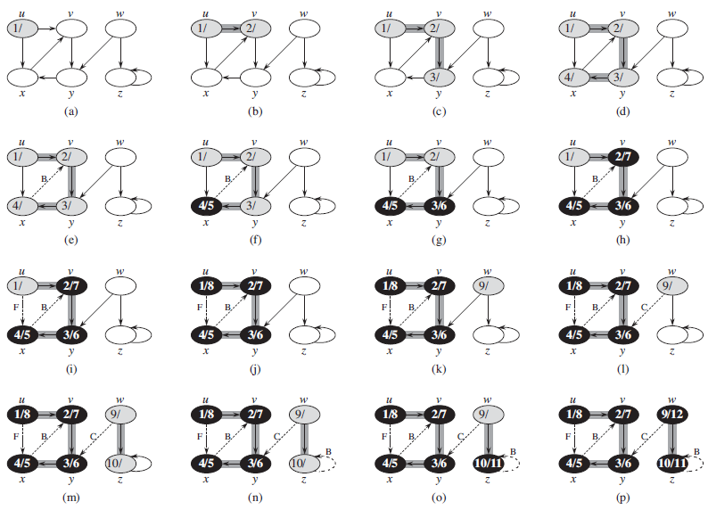
Deadlock Detection
<number> / 51
  A dead simple cycle detection algorithm (O(n), n = # vertices).
  Graph G has a cycle iff DFS on G has a back edge.
  Back edge (u, v) connects u to an ancestor v in a depth-first tree.

Slide 47

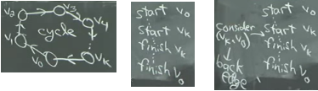
Deadlock Detection
<number> / 51
  A dead simple cycle detection algorithm (O(n), n = # vertices).
  Graph G has a cycle iff DFS on G has a back edge.
  Proof: just for fun.
  Left direction: if DFS(G) has a back edge, then G has a cycle.
  Right direction: if G has a cycle, then DFS(G) has a back edge.
  Assume v0 is the 1st vertex in the cycle visited by DFS. Claim: (vk, v0) is a back edge. v1 visited before we finish visiting v0. similarly vi …. vi-1; and vk … v0. So we definitely consider (vk, v0) between start vk and finish vk, and when considered it’ll be a back edge ‘cos ancestor v0 is currently in process (in the recursion).
Notes:
Depth-first search (DFS): it goes as deep as it can before backtrack.

Slide 48
Deadlock Detection
<number> / 51
Multiple instances for each resource type.
Available: A vector of length m indicates the number of available resources of each type.
Allocation: An n x m matrix defines the number of resources of each type currently allocated to each process.
Request: An n x m matrix indicates the current request of each process. If Request [i][j] = k, then process Pi is requesting k more instances of resource type Rj.
No need for a Max matrix to be declared by the processes in the beginning (easier).

Slide 49
Deadlock Detection
<number> / 51
1. Let Work and Finish be vectors of length m and n, respectively Initialize:
  (a) Work = Available
  (b) For i = 1,2, …, n, if Allocation_i != 0, then
  Finish[i] = false; otherwise, Finish[i] = true
2. Find an index i such that both:
  (a) Finish[i] == false
  (b) Request_i <= Work
  If no such i exists, go to step 4
3. Work = Work + Allocation_i
  Finish[i] = true
  Go to step 2
4. If Finish[i] == false, for some i, 1 <= i <= n, then the system is in deadlock state. Moreover, if Finish[i] == false, then Pi is deadlocked

Slide 50
Deadlock Detection
<number> / 51
An example: Five processes P0 through P4; three resource types
A (7 instances), B (2 instances), and C (6 instances). Existing = [7 2 6]
Snapshot at time t:
Allocation Request Available
A B C A B C A B C
P0 0 1 0 0 0 0 0 0 0
P1 2 0 0 2 0 2
P2 3 0 3 0 0 0
P3 2 1 1 1 0 0
P4 0 0 2 0 0 2
Trigger deadlock detection algorithm
Sequence <P0, P2, P3, P1, P4> will result in Finish[i] = true for all i

Slide 51
Deadlock Detection
<number> / 51
Assume P2 makes a request [0 0 1]
Snapshot at time t2:
Allocation Request Available
A B C A B C A B C
P0 0 1 0 0 0 0 0 0 0
P1 2 0 0 2 0 2
P2 3 0 3 0 0 1
P3 2 1 1 1 0 0
P4 0 0 2 0 0 2
P0 runs and terminates and Available = [0 1 0], which cannot satisfy any other process requests: Deadlock detected.

Slide 52
Deadlock Detection
<number> / 51
Detection algorithm usage
When, and how often, to invoke depends on:
  How often a deadlock is likely to occur?
  How many processes will need to be rolled back?
    one for each disjoint cycle

